Slide 1


CareVis Aiding the one who save our lives
TEAM JARVIS:
IIT BHU, Varanasi

Slide 2

INDIA: IMPOTENT HEALTHCARE SYSTEM
TOTAL REGISTERED DOCTOR
1.04 MILLION
POPULATION OF INDIA
1.35 BILLION
ONE DOCTOR FOR
1457 CITIZENS
HEALTHCARE INDEX RANK 154 AMONG 195 COUNTRIES
95 ICU BEDS FOR
1000 CITIZENS
MORE INDIAN DIE OF POOR QUALITY CARE THAN DUE TO LACK OF ACCESS TO HEALTHCARE
1.6 MILLION DEATHS DUE TO POOR QUALITY OF CARE
2 TIMES MORE THAN DEATHS DUE TO NON UTILISATION OF HEALTHCARE SERVICES
DOCTORS TO PATIENT RATIO IN INDIA: 1.34 DOCS FOR 1000 CITIZENS
POOR MEDICAL ATTENTION IS THIRD LARGEST CAUSE OF DEATH CareVis will assist Medical Practitioner to minimize human loss due to error in caring

Slide 3
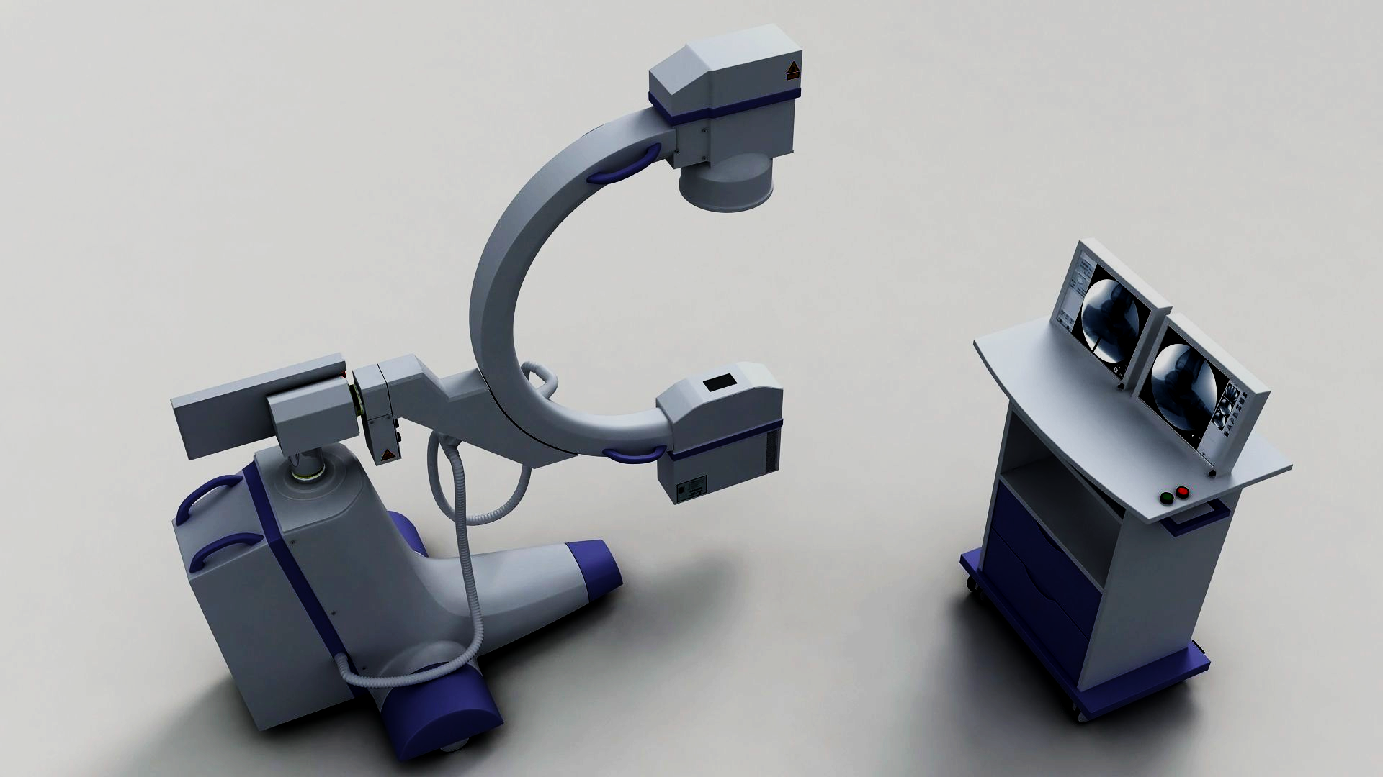
CareVIS
DEVELOPING AI BASED TREATMENT ADVICE SYSTEM FOR MEDICAL PRACTITIONER TO REDUCE GAPS IN CARE
MVP Product Features
A Rank-based system of patient’s criticality
Survival Probability : Prediction of In-Hospital Mortality (0: SURVIVED; 1: DEATH) with probabilities of survival class determining the criticality of the patient.
Length of the Stay: Estimating the duration of stay of patients in ICUs from admission till discharge.
Treatment Advice: .Recommending additional vitals for patients’ Electronic Health Record.
Actionable Insights: Comprehending millions of data points to gain insights on behavior of the diseases based on Hospitals, Locations etc over a period of time.

Slide 4
250000
75%
Deaths Every Year due to Medical Error.
Third leading cause of Deaths
Increase on risk of death For each 30 min Of delayed diagnosis.
30%
80%
Reduction in Household cost that goes into medical issues
Lives Saved with the Help
Of Rapid Diagnosis

Slide 5




USERS PAIN POINTS
Sumit is Senior Doctor in Government Hospital in Bulandshahr. There is heavy load in the ICU of this Hospital. Many times He need to Refer the Critical Patient to AIIMS Delhi. But there are many times judgment error and delay in refers on cost of lives. Then he subscribed with CareVIS which help him to predict Survival probability and help him to make wise decision. Sumit is smart, Be like Sumit.
Aditi is Doctor in Private Hospital. She needs to manage 100 Patients daily in ICU. Using CareVIS make her life easy. She gets summarized picture of condition of Patient and also what variables need to be tracked to increase the probability of the survival patient. This help her to minimize the error in caring of the patients.
This is management team of one of leading Hospital. They use CareVIS to manage their Critical Patients in ICU and track of condition of patients, In future ICU Beds availability, Mortality rate and this helps them for better planning and making wise decision. Smart Team with smart decision.

Slide 6
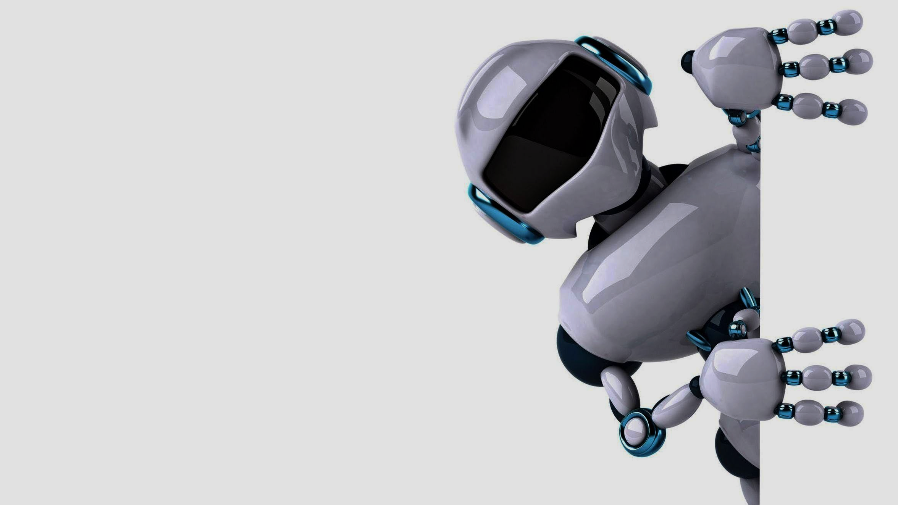
MODEL ARCHITECTURE
INPUT (PATIENT VITALS)
VITAL SELECTION MODULE
IMPUTATION MODULE
CLASSIFICATION: ML PREDICTIVE MODEL
SURVIVAL PROBABILITY
RECOMMENDING ADDITIONS VITALS
ESTIMATING LENGTH OF STAY IN ICU
Suggest Patient Criticality
Completes Health Records
Helps to manage ICU Beds

Slide 7








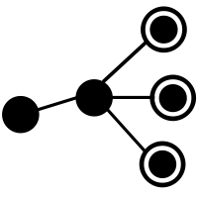
CLOUD ARCHITECTURE
TRAIN DATA
Product Database
CAREVIS
USER Hospital
AWS Cloud Server Dynamic Training of the Model
AWS EC2 Instance
DEPLOYMENT
New Patient Data
API CALLS
By Hospitals
SAAS
Predicting Survival Probability, Prediction of Length of Stay
Additional Vitals

Slide 8
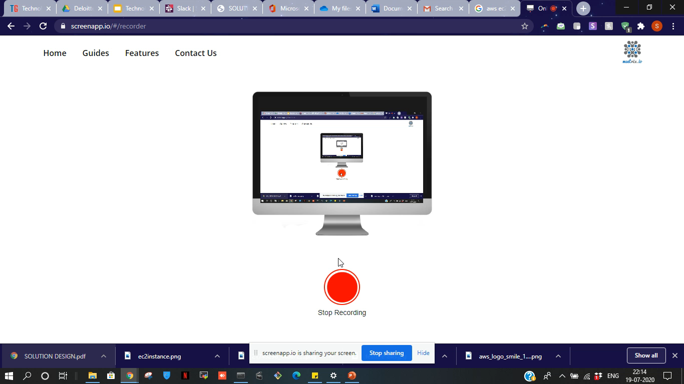
Working of the Web app on cloud

Slide 9

Business Model
Value Proposition AI Treatment Advice models which predicts the Survival Probability with accuracy x% of critical patients through various variables collected during Intensive Care and also recommends right additional parameter to keep in track in order to improve the Probability of Survival.
Customers Segmentation 1) Private Hospitals 2) Government Hospitals 3) Medical Research Center | Cost Structure 1) App Development Cost 2) Cloud Storage Cost | Revenue Streams 1) Subscription Model 2) Capacity Wise

Slide 10

MARKET POTENTIAL
Number of ICU Beds in Public Sector: 35,000 +
Number of ICU in Private Sector: 60,000 +
Cost of ICU/Day: INR 1000 +
Pricing Model for our product will work on subscription model. Where Hospital needs to pay us subscription fees depending upon the no. of patients they want to cover through this product. On average 50% of the ICU Beds are occupied. No. of Patients that can be covered through this App: 47,500 Let’s say per day price of our subscription lies on average INR 100/Patient (10% Cost of ICU) Let’s assume 10% of Conversion rate In one year, CareVIS can generate Revenue = 171 Million

Slide 11
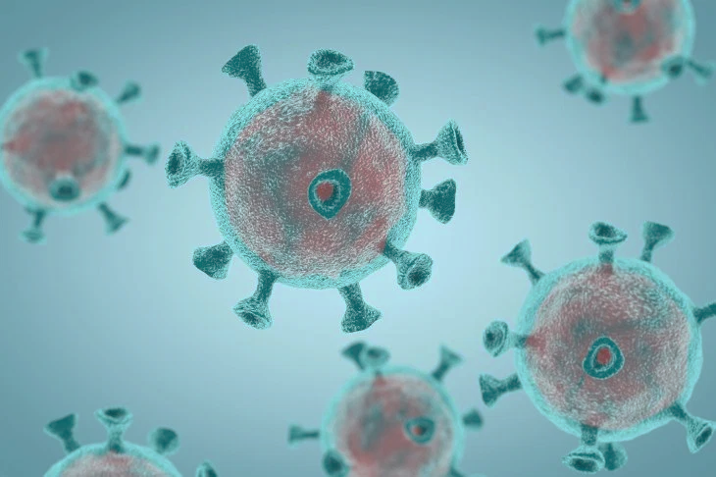
COVID-19
Challenges faced by Health Workers during this pandemic and how can CareVis assists them to fight this pandemic?
Work Overload
Not Enough Time Spent
Limited Number of ICU Beds
User Pain points mentioned earlier is significantly increased during this pandemic. CareVis can play major role in assisting doctors by minimizing the Gaps in Cares and reducing the care required per patient. Also by predicting the number of beds available in future can assists Hospital Management Team/Government to expand resources or do necessary actions.
Our MVPs Model Is Not Trained On COVID-19 Patient Data.

Slide 12





SWOT ANALYSIS
STRENGTH | Actionable Insights | Low False Positive Rates
WEAKNESSES | Cannot Completely Remove Human Intervention | Under Confident Prediction in case of less data
OPPORTUNITIES | Medical Research | AI in HealthCare
THREATS | Too much dependency | New Medical Norms

Slide 13

THANK YOU
Team: JARVIS, IIT BHU
SUMIT KESHAV
HRITWIK SINGHAI
PRASHANT PANDEY

Slide 14
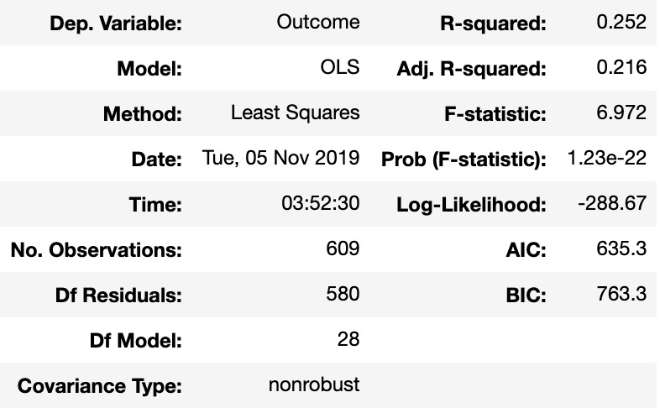
APPENDIX
Imputation: SK Learn iterative Imputer, Bayesian Ridge estimator : Ascending imputation
Reduced Feature set after OLS(Ordinary Least Squares): 'Age’, 'BUN', 'Creatinine', 'DiasABP', 'FiO2', 'GCS', 'Glucose', 'HCO3’, 'HCT', 'HR', 'ICUType', 'K', 'MAP', 'Mg’, 'Na', 'PaCO2', 'PaO2', 'Platelets','Gender’, 'RecordID', 'SysABP', 'Temp', 'Urine', 'WBC', 'Weight', 'pH’.
XGBoost parameters: 'colsample_bytree': 1, 'gamma': 0, 'learning_rate': 0.06, 'max_depth': 5, 'subsample': 0.9
OLS Results

Slide 15

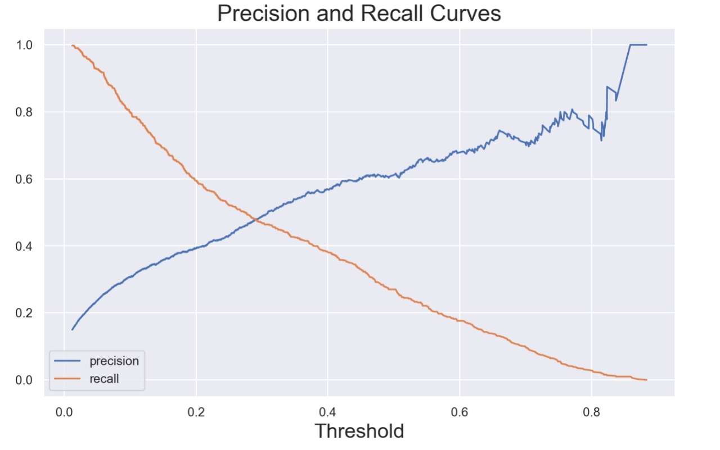
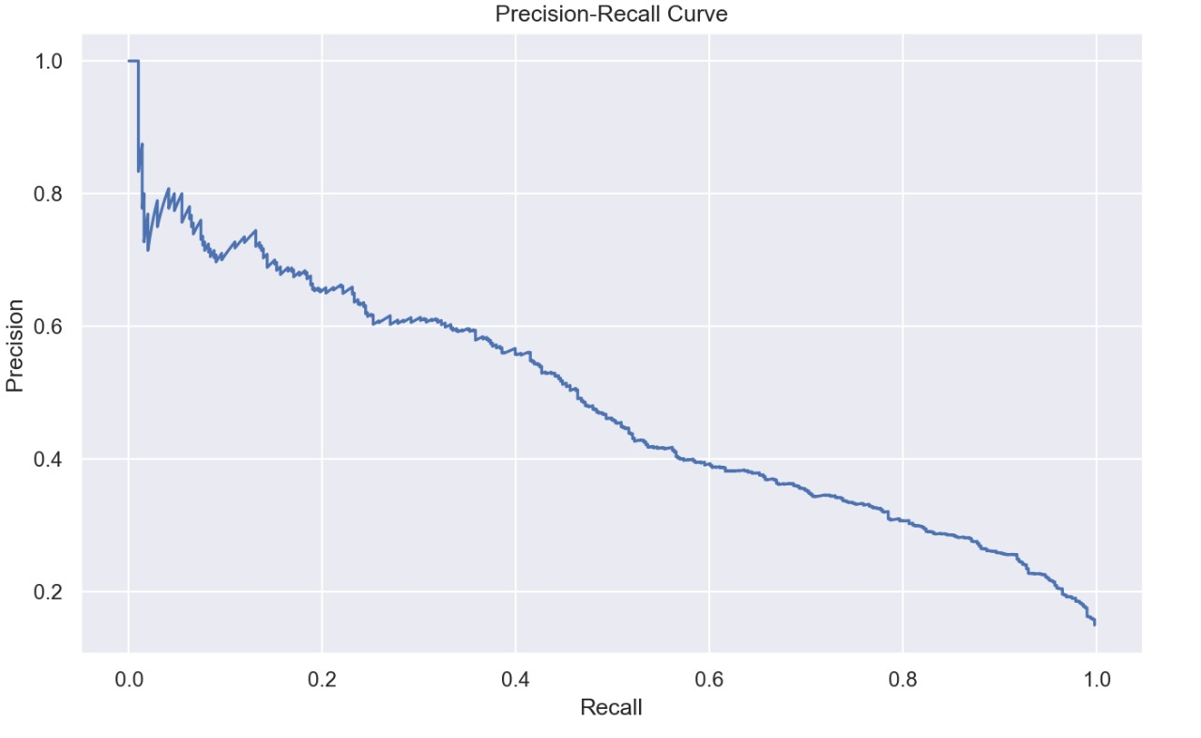
PRECISION RECALL CURVES

Slide 16
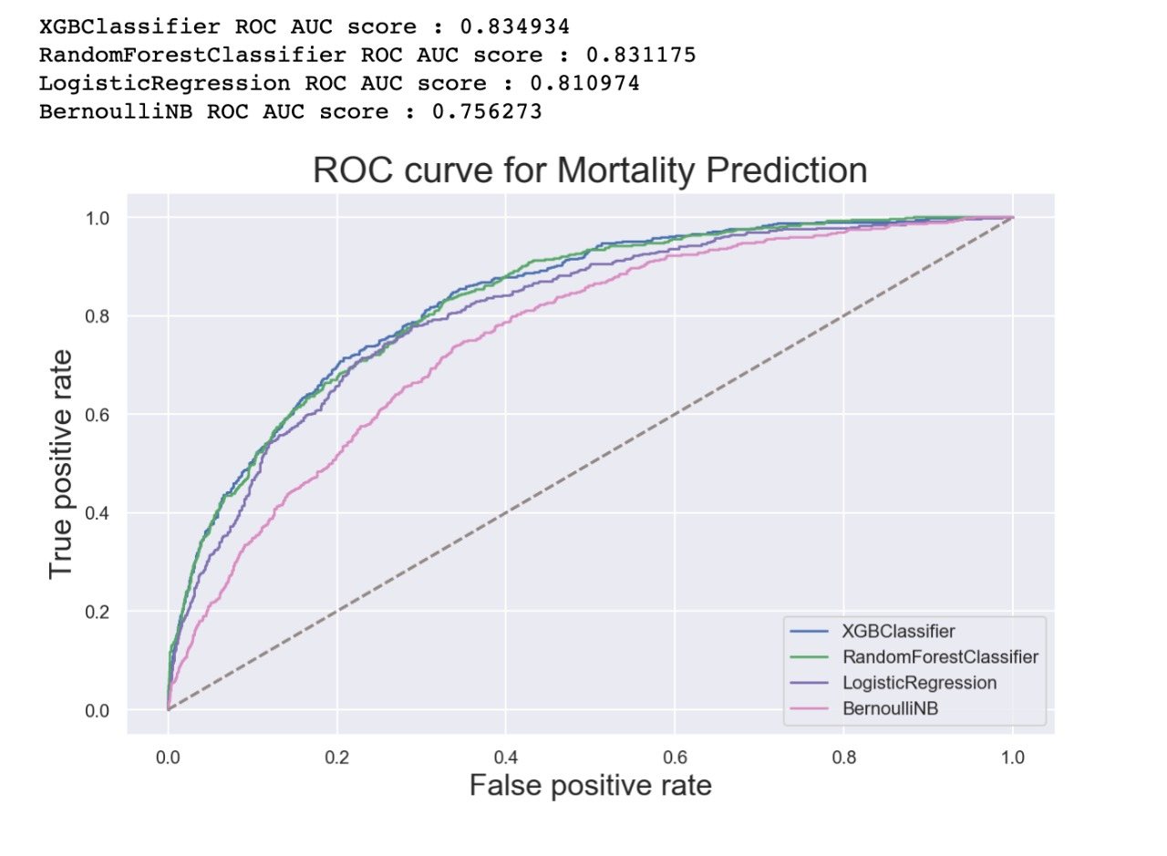
ROC & AUC SCORES FOR VARIOUS MODELS

Slide 17
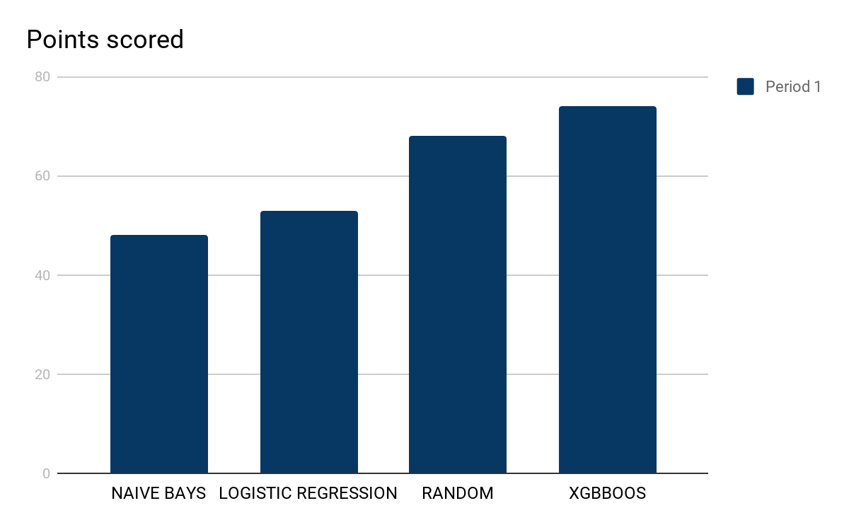
MODEL EVALUATION METRICS
Most of the Patients Survive, Distribution is Skewed.
Hence we select F1 Score and ROC Curve Better Metrics

Slide 18
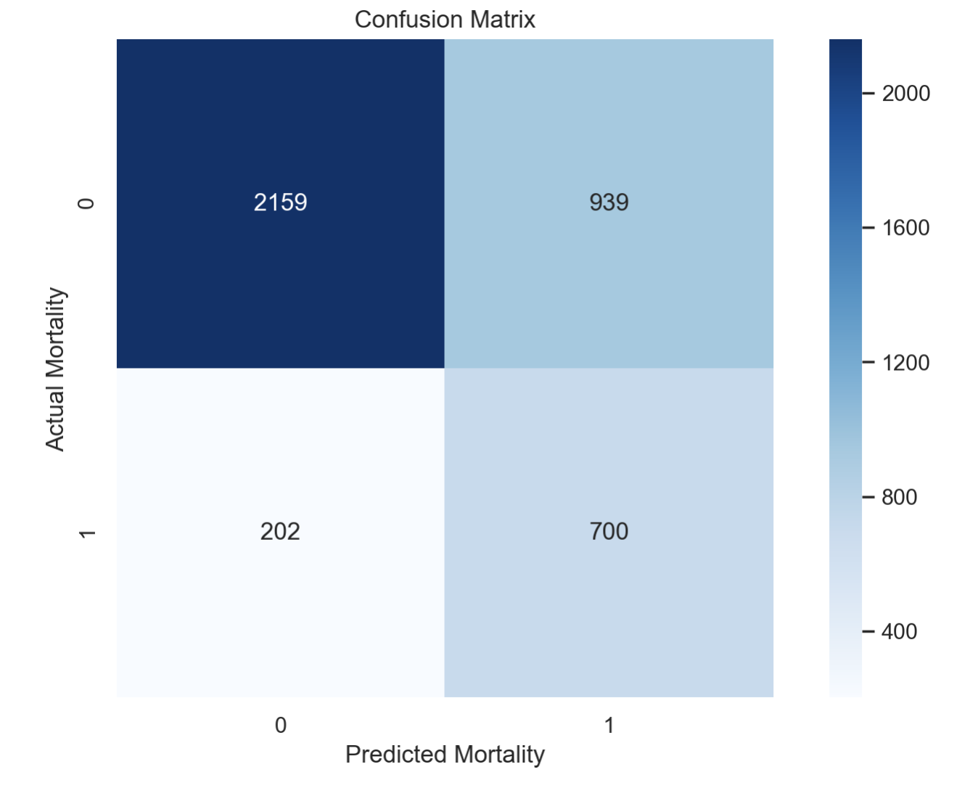
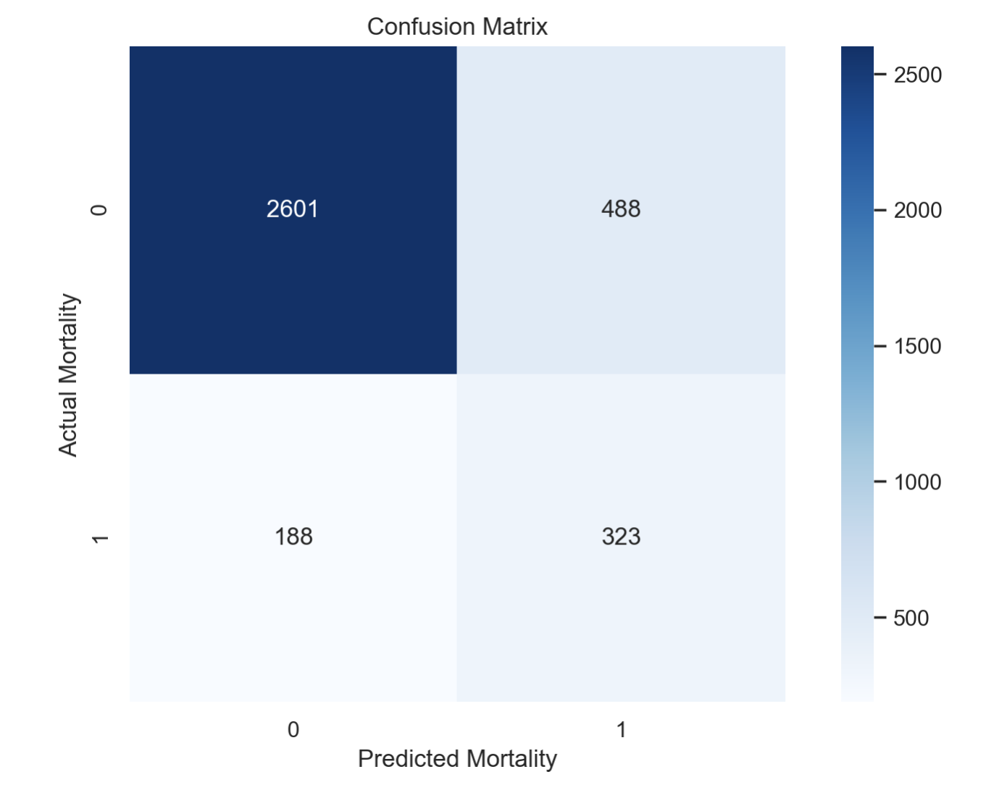
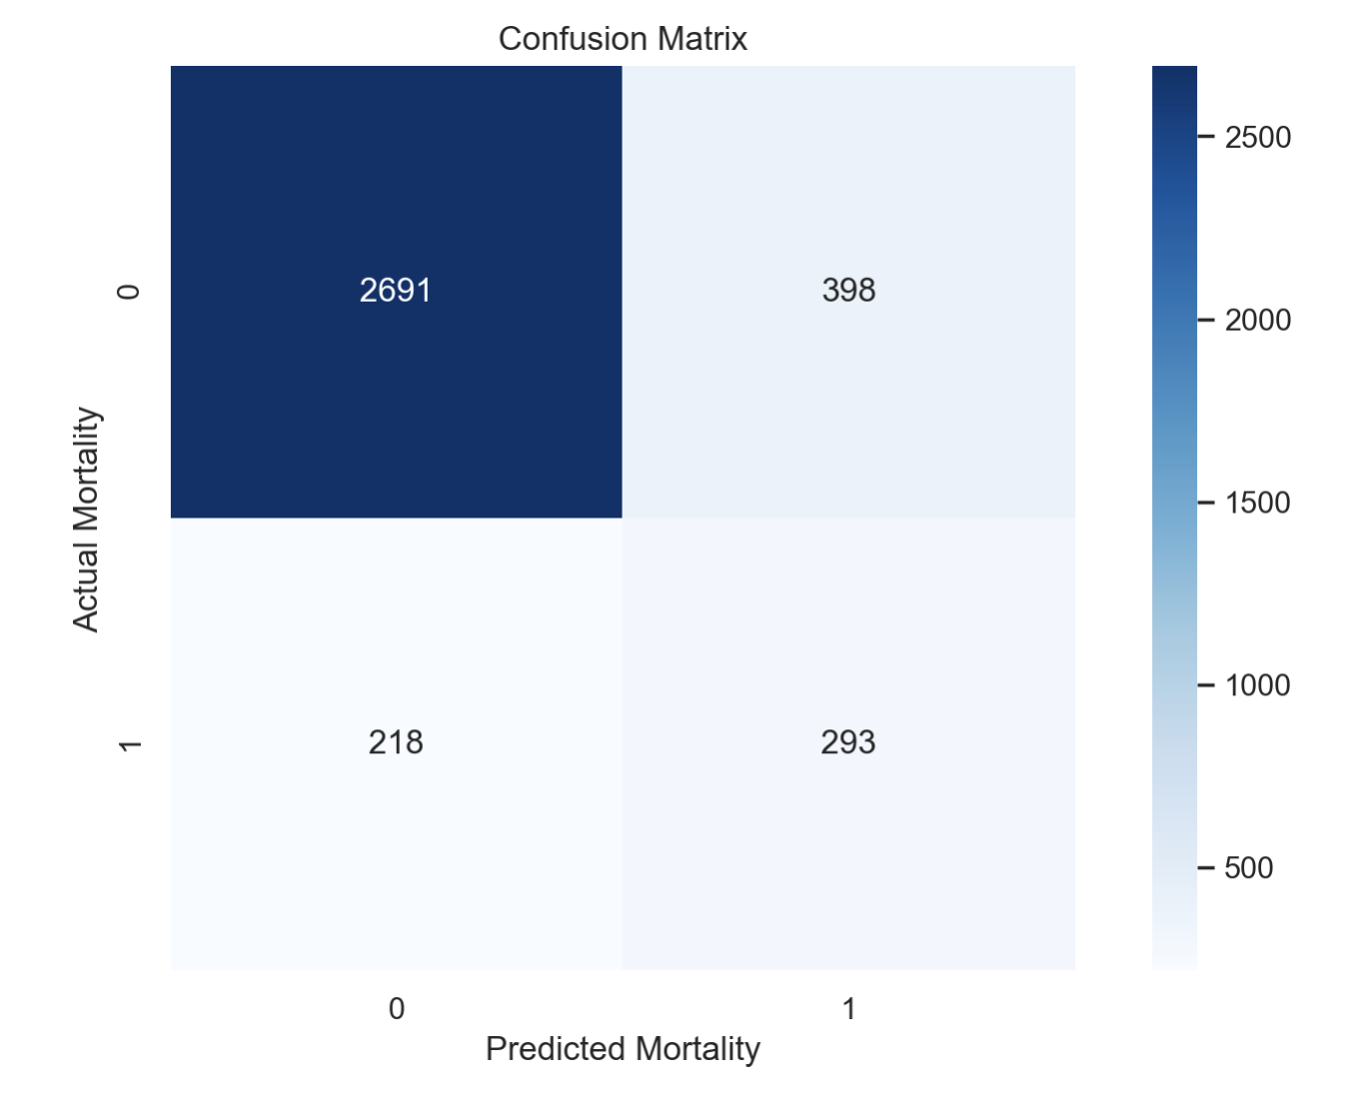
REDUCING THE FALSE POSITIVE RATE
Initial FPR (Raw Data)
Impute Using Bayesian Ridge
Use XGBoost Ensembling with Correlated Features Removed
FPR : 0.3
FPR : 0.15
FPR : 0.12

